Slide 1
Review of Legislation for the Water Sector and for Drafting of a Water Resources Bill for Mauritius
Consultation Workshop 11th October 2022
Presentation 2

Slide 2
SCOPE AND CONTENT FOR THE WATER RESOURCES BILL

Slide 3
Scope of Draft Bill - overview
1. Legal principles governing water resources
2. Institutional framework to manage water resources
Introduction of water use permits
Management of surface and ground waters
Protection of water resources
Conservation of water resources
Water services
Regulations
Transitional provisions

Slide 4
1. Legal principles governing water resources
Key Considerations>
All water vested in State
Entitlement to use subject to regulation
Responsibility to use efficiently and for specified purpose
Integrated Water Resources Management - based on “whole of catchment”
Polluter pays
Social and economic benefit from use of water
Government to hold permits records.

Slide 5
2. Institutional framework to manage water resources
Key Considerations>
Clarify roles and responsibilities(Current status,Mgt shortcomings etc)
Identify required institutional changes
Provide for new roles in law as necessary ( Cope with changes..CC, LT Sustainability)

Slide 6
3. Introduction of water use permits
Key Considerations>
Procedures for application
Awarding of water use permits
Appeals – reconsideration – negotiation
Last resort – recourse to the law

Slide 7
4. Management of surface and ground waters
Key Considerations>
Holistic / integrated approach(Conjunctive)
Optimise management to increase benefits for all
Water Resources Monitoring Ctees and Water Licence Ctees
Permit reqmts.

Slide 8
5. Protection of water resources
Key Considerations>
Quality
Pollution control
Enforcement
Responsibility of borderers and buffer zones.

Slide 9
6. Conservation of water resources
Key Considerations>
Reduce/ recover “lost water”
Water use efficiencies
Improved water environment
Water reuse
Rainwater Harvesting

Slide 10
7. Water Services
Key Considerations>
Water Resources management roles to be moved from CWA Act to Water Resources Bill.
How to enable new suppliers to enter ( eg desalination)
A supplier of water cannot be a regulator – clarify regulator roles.

Slide 11
8. Regulations
Key Considerations>
Extensive array of regulations required
Coherent joined up package
Provide the clarity to implement and use new procedures
Standard setting

Slide 12
9 Transitional provisions
Key Considerations>
Enabling us to move from where we are to where we need to be.
How to implement this act.
Opportunity for phased implementation “learn and improve”.

Slide 13
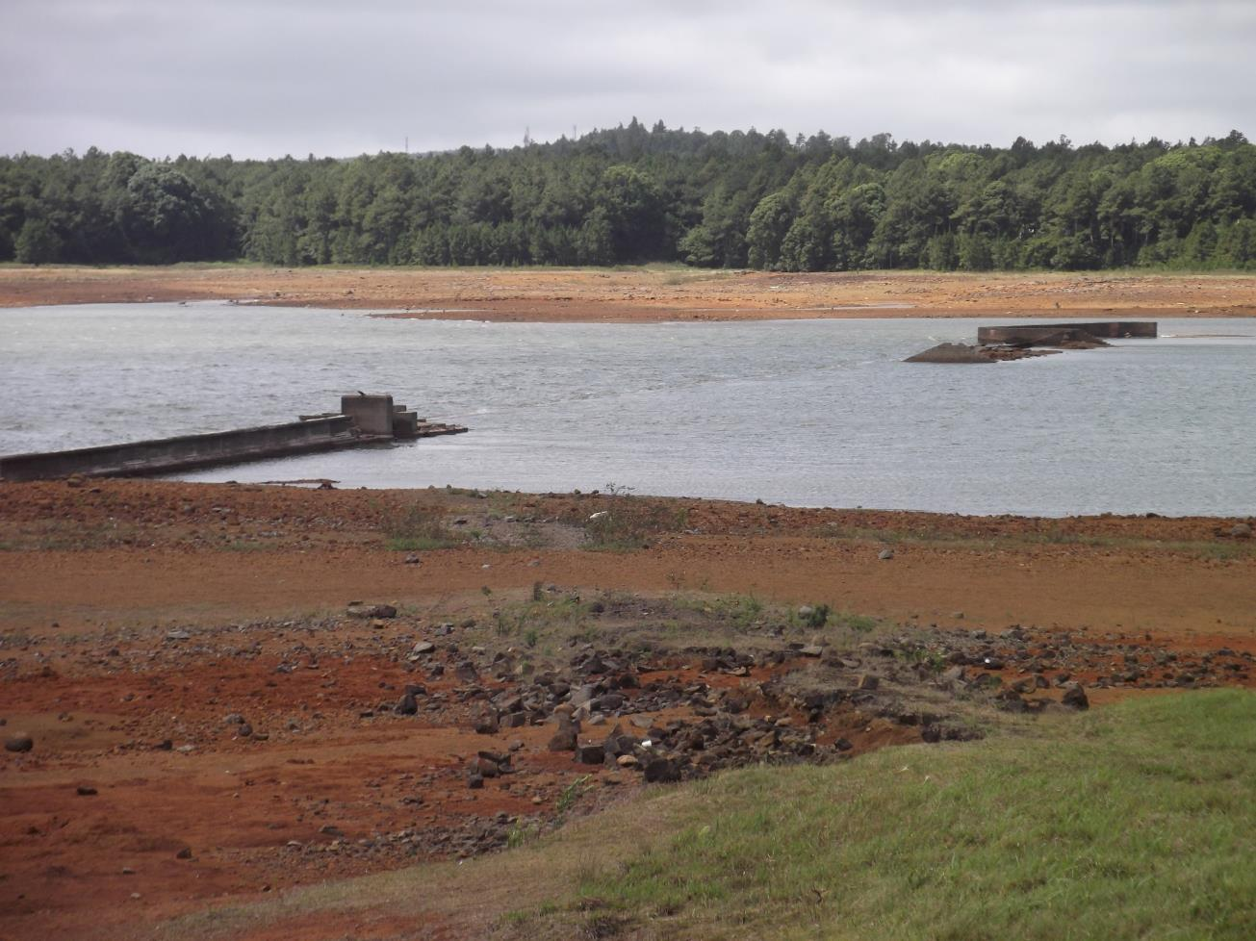
THANK YOU

