Slide 1
Review of Legislation for the Water Sector
Consultation Workshop 11th October 2022
Opening Session
Melvin Woodhouse

Slide 2
Overview of Presentation
Why does Mauritius need a Water Resources Act?
What will it address?
What are the intended benefits?

Slide 3
Overview of Presentation
Why does Mauritius need a Water Resources Act?

Slide 4
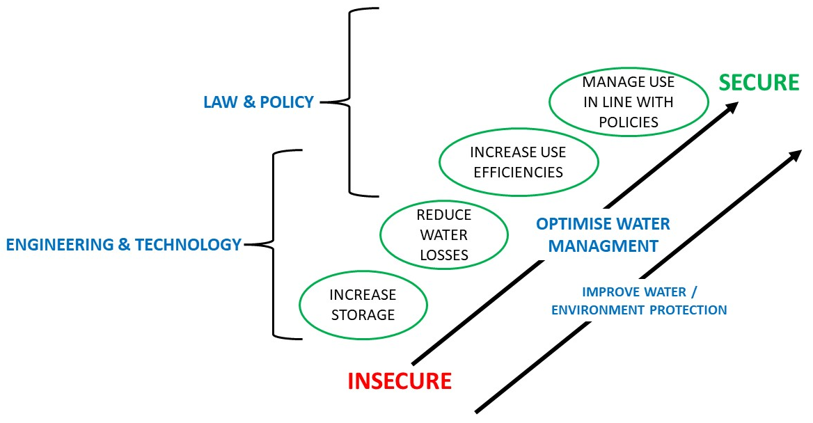
Why does Mauritius need a Water Resources Act?
Key Consideration> How can Mauritius become Water Secure?

Slide 5
Why does Mauritius need a Water Resources Act?
Key Considerations>
Rivers and Canals Act is fundamentally unchanged in 160 years
Mauritius is a now very different country, facing greater water stress and new pressures
Population
Economy
Environment
Climate
Competing demands
Employment
Energy
Food
Other related legislation is old and now fragmented e.g. Public Health Act 1925, CWA Act 1971

Slide 6
Why does Mauritius need a Water Resources Act?
Key Considerations
Legal and institutional frameworks are fragmented – overlaps and gaps – no clear / unified approach to manage nations water.
All water is public property – vested in the State ; hence responsibility to ensure reasonable and equitable use, safeguard legitimate uses, safeguard water and its associated environment.
RCA provisions are no longer an adequate “tool” to enable the effective management and protection of water resources

Slide 7
Overview of Presentation
What will a Water Resources Act address?

Slide 8
What will Water Act Address?
1. Clearly state the legal principles governing all water resources
2. The institutional framework to manage water resources
Introduction of water use permits
The management of surface and ground waters
Protection and conservation of water resources
Management of dams
Water services
Regulations
Transitional provisions

Slide 9
Why does Mauritius need a Water Recent Act?
Recent judicial decisions – Privy Council
Appellants could not satisfy the Board that their historic “water rights” were adequate proof of approval to use water - the Board based their decisions on the fundamental legal principles (normative rules) found in the Rivers and Canals Act 1863
For example
Water cannot be owned as a private property – all water is in the Domaine Publique
A right to use water is not awarded because of ownership of land. It follows that sale of land doesn’t transfer water rights – they are separate and unconnected to each other
The right to water is not an exclusive right. “ All borderers have the same rights, but their shares may be different”
Historic use over time is not valid proof of a right to use water (a prescriptive right)
A water “right” holder has an obligation to pay for the use of that water

Slide 10
Overview of Presentation
What are the intended benefits of a Water Resources Act ?

Slide 11
What are the intended benefits of a Water Resources Act?
Legal Framework- unified and harmonised
Institutional Framework – coherent and effective
Water Use Permit System fair / transparent / accountable system for all significant uses
Regularise present water use permits
Regulate, protect and enforce the safeguarding of the Nations water resources (quality & quantity)

Slide 12
What are the intended benefits of a Water Resources Act?
Some examples
Legal Framework:
EU Water Framework Directive – Catchment Based Planning is a legal requirement
New Zealand – Catchment based planning
Seychelles – water rationing was uncommon but in November 2021 supply was restricted to 12 hours a day – Water laws are old and fragmented – priority is to revise legal framework for water
Institutional Framework
Gambia > Meteorology functions of hydrology department established as a parastatal body.
Water permit system – reasonable & equitable use
South Africa > negotiating transition – win-win outcomes

Slide 13
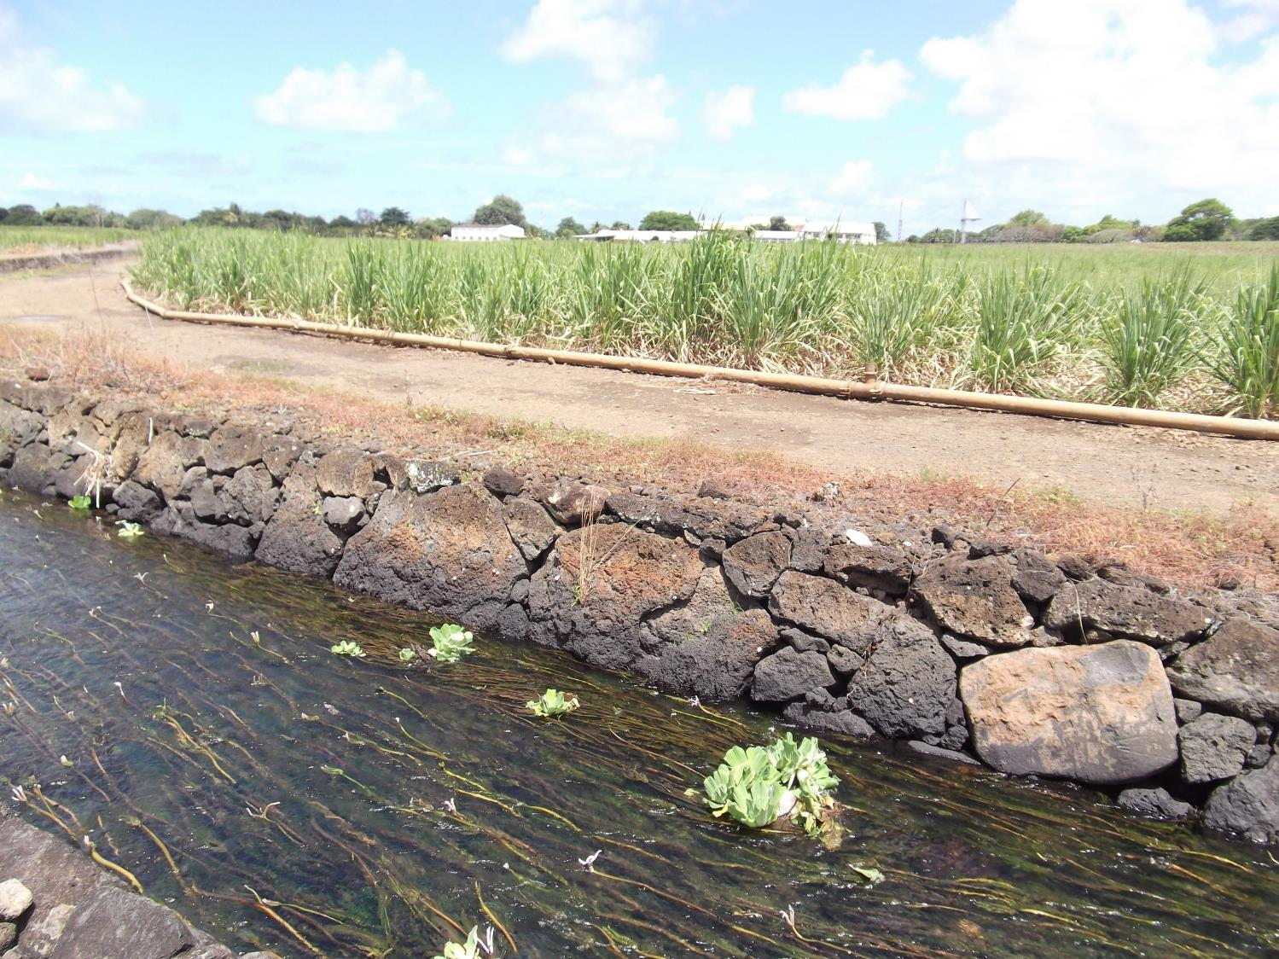
Investment Programmes Rural Water Mobilization– Example of MoWRD Flagship options

Slide 14
Comments
Water Resources Act would prepare Mauritius for the future – using tools for the future.
Significant agenda to implement it > calls for strategic and wise/ scheduled implementation which plans for success and avoids failures.
Adversarial law fails to resolve water sharing issues – its outcomes are limited to one winner and one loser.
New approaches are needed – properly informed by technical understanding and supported by intelligent negotiation and appeals procedures. Recourse to the courts remains available as a final resort.

Slide 15
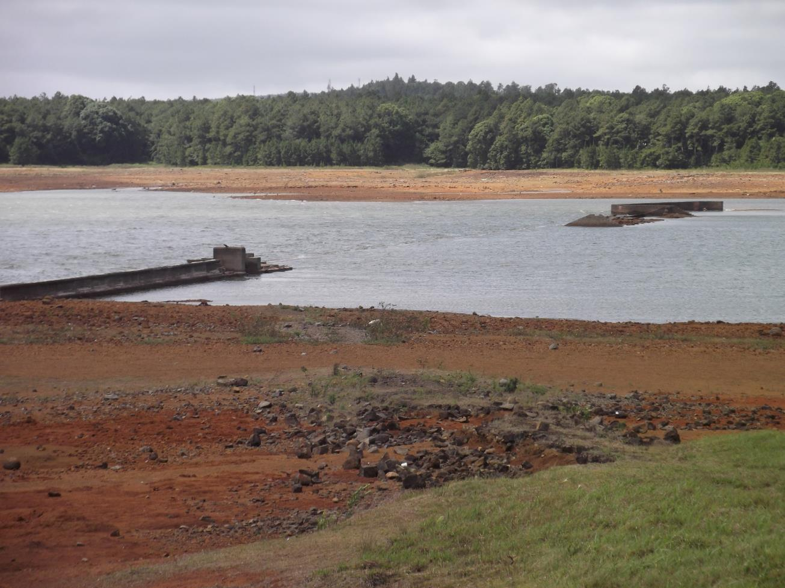
THANK YOU

